Slide 1
Time & Work
Rayudu J J Dhanamjaya
Aptitude Trainer
Aditya Engineering College (A)

Slide 2
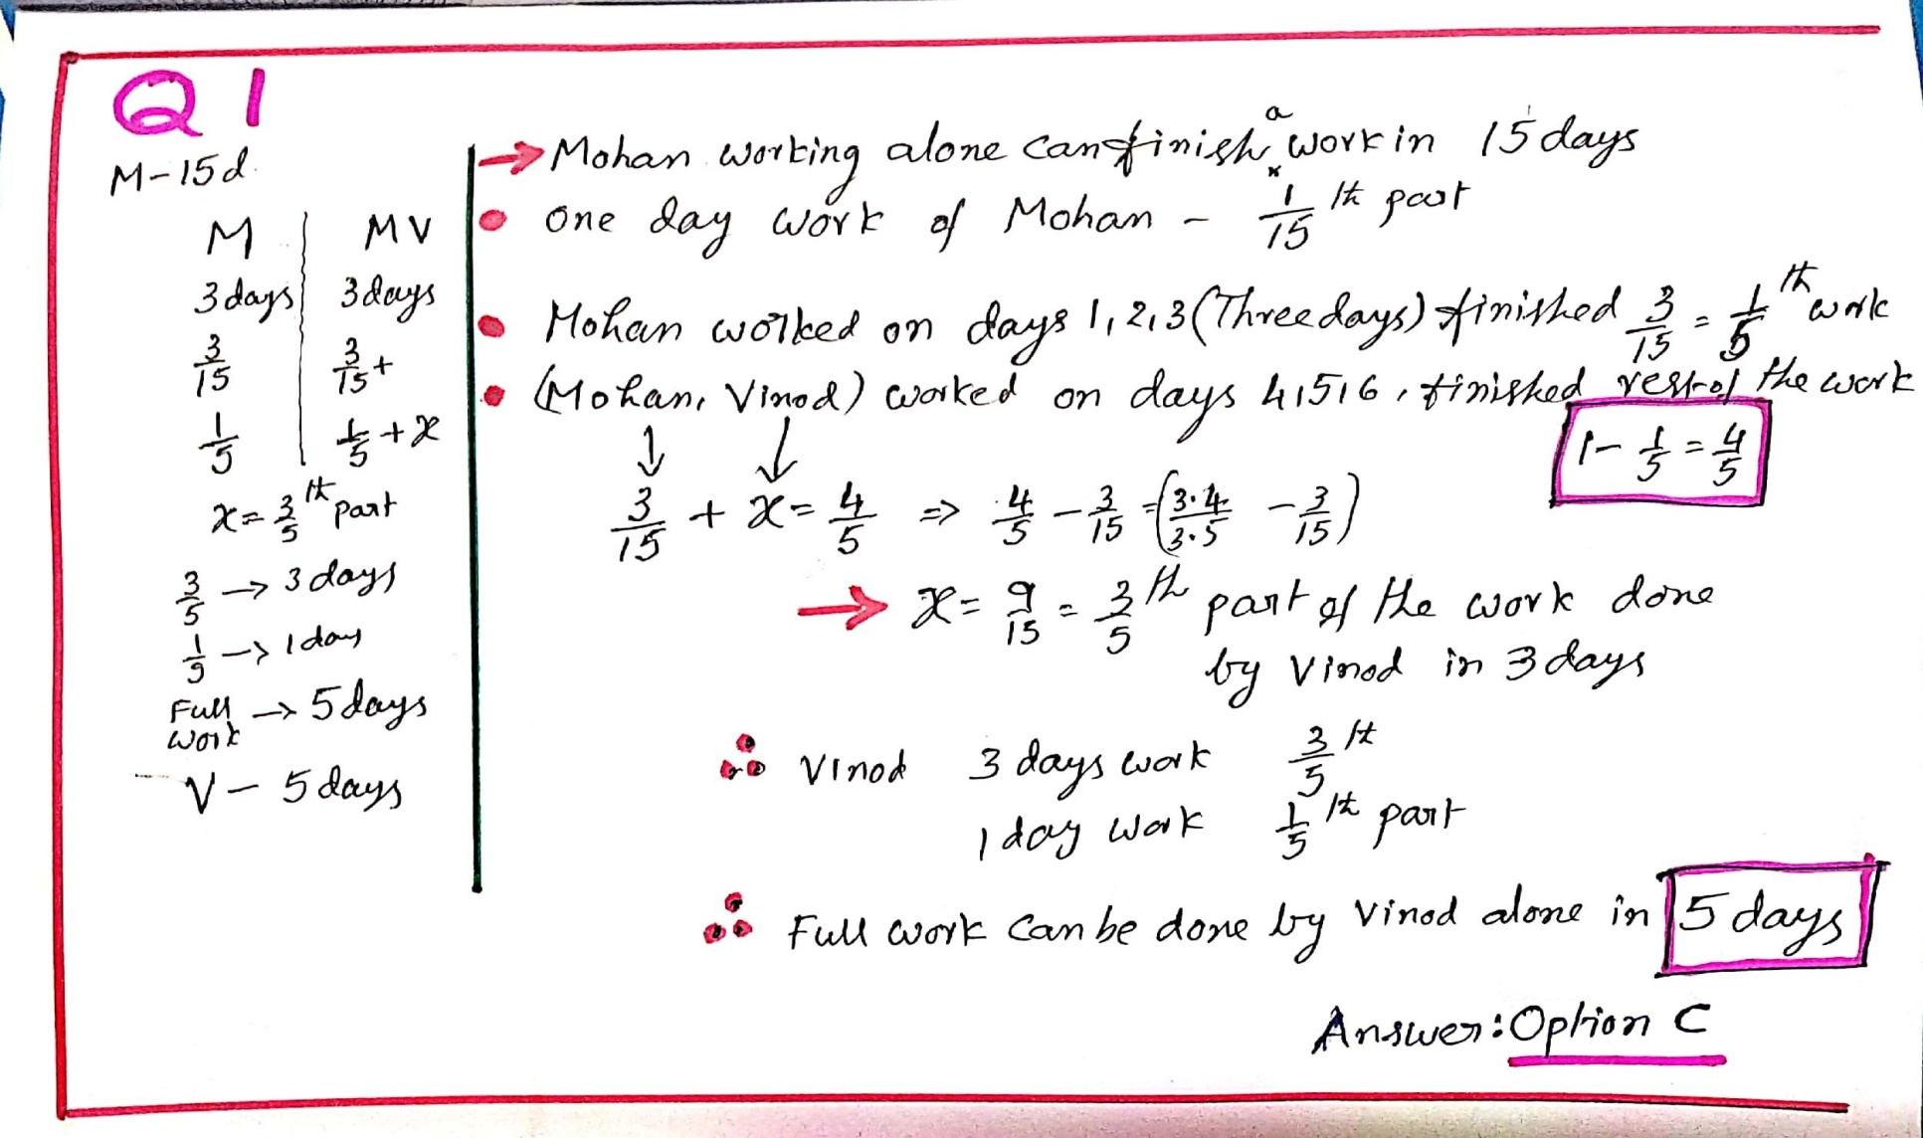
Q (1) _
Mohan can do a work in 15 days. After working for 3 days he is joined by Vinod. If they complete the remaining work in 3 more days, in how many days can Vinod alone complete the work?
A)10 days B)8 days C)5 days D)12 days Answer :C
on paper EXPLANATION

Slide 3
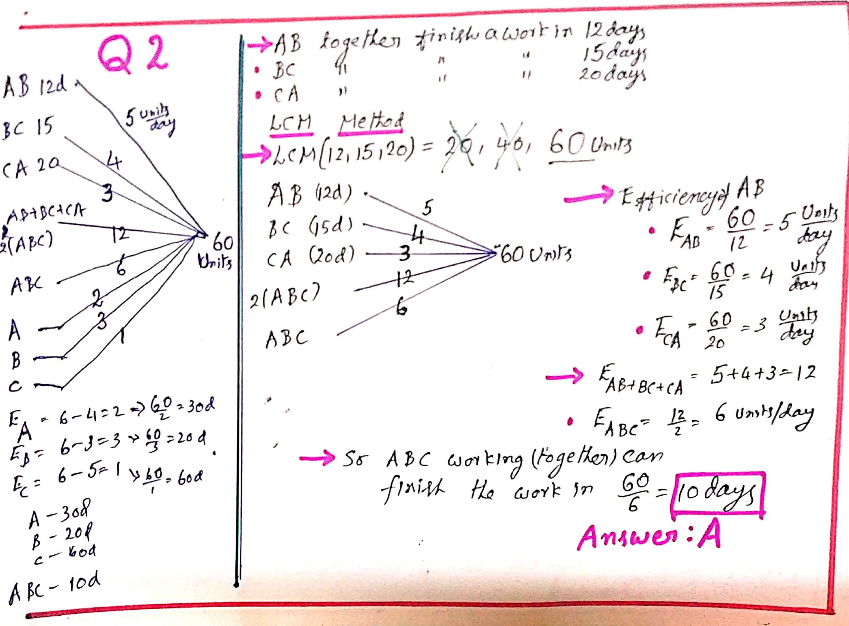
Q 2.__
A and B can do a work in 12 days, B and C can do the same work in 15 days and A and C can complete the work in 20 days. In how many days A, B and C working together can complete the whole work?
A)10 days B)12 days C)8 days D)14 days Answer :A
on paper EXPLANATION

Slide 4
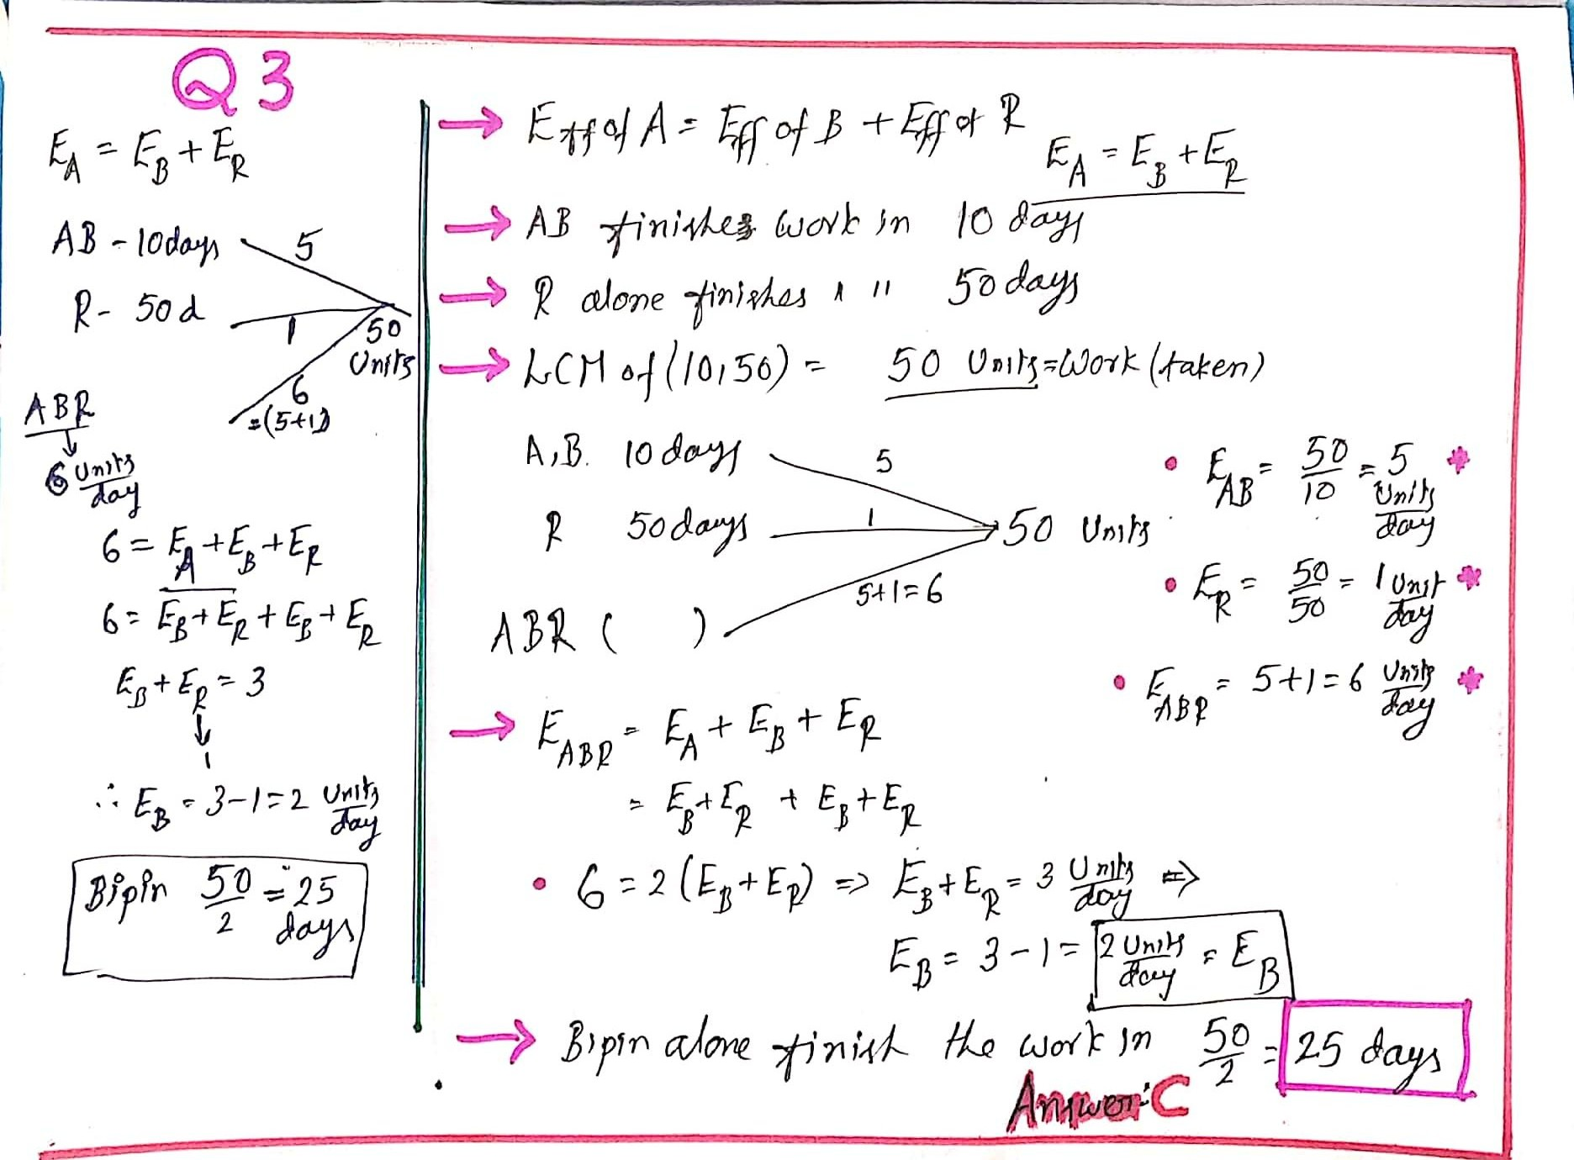
Q.3
Arun can do a certain work in the same time in which Bipin and Rahul together can do it. If Arun and Bipin together could do it in 10 days and Rahul alone in 50 days, then Bipin alone could do it in:
A)15 days B)20 days C)25 days D)30 days Answer :C
on paper EXPLANATION

Slide 5
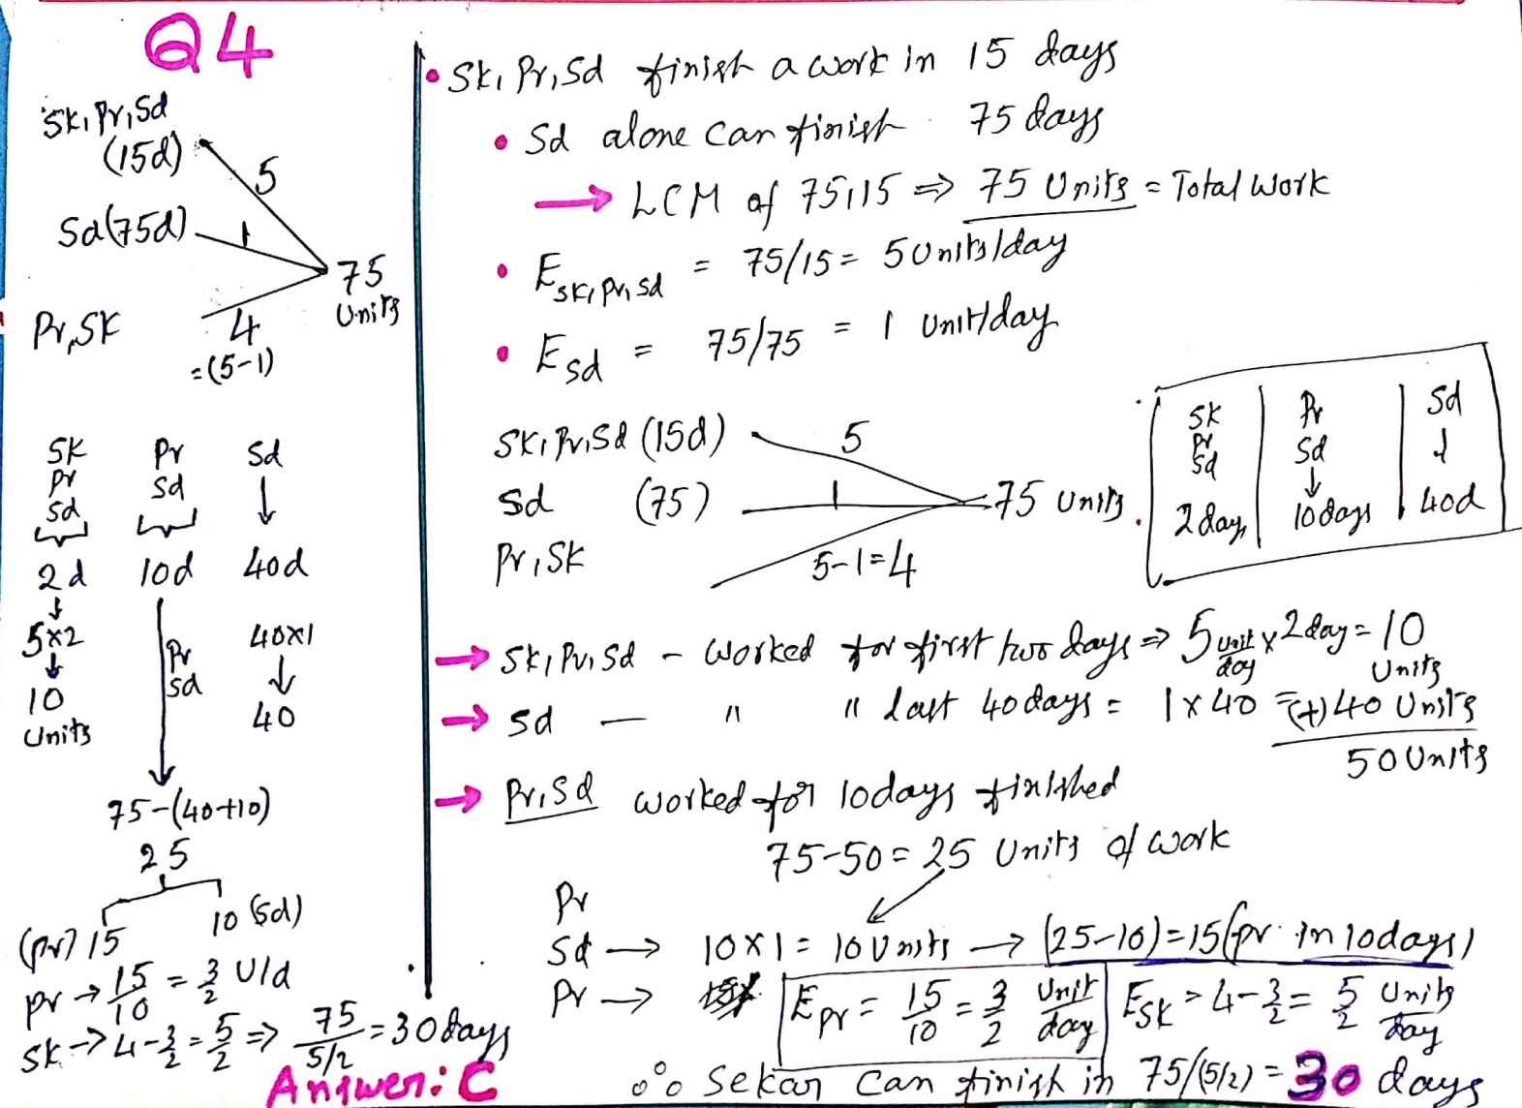
Q 4.___Sekar, Pradeep and Sandeep can do a piece of work in 15 days. After all the three worked for 2 days, sekar left. Pradeep and Sandeep worked for 10 more days and Pradeep left. Sandeep worked for another 40 days and completed the work. In how many days can sekar alone complete the work if sandeep can complete it in 75 days?
A)25 days B)20 days C)30 days D)35 days Answer :C
on paper EXPLANATION

Slide 6
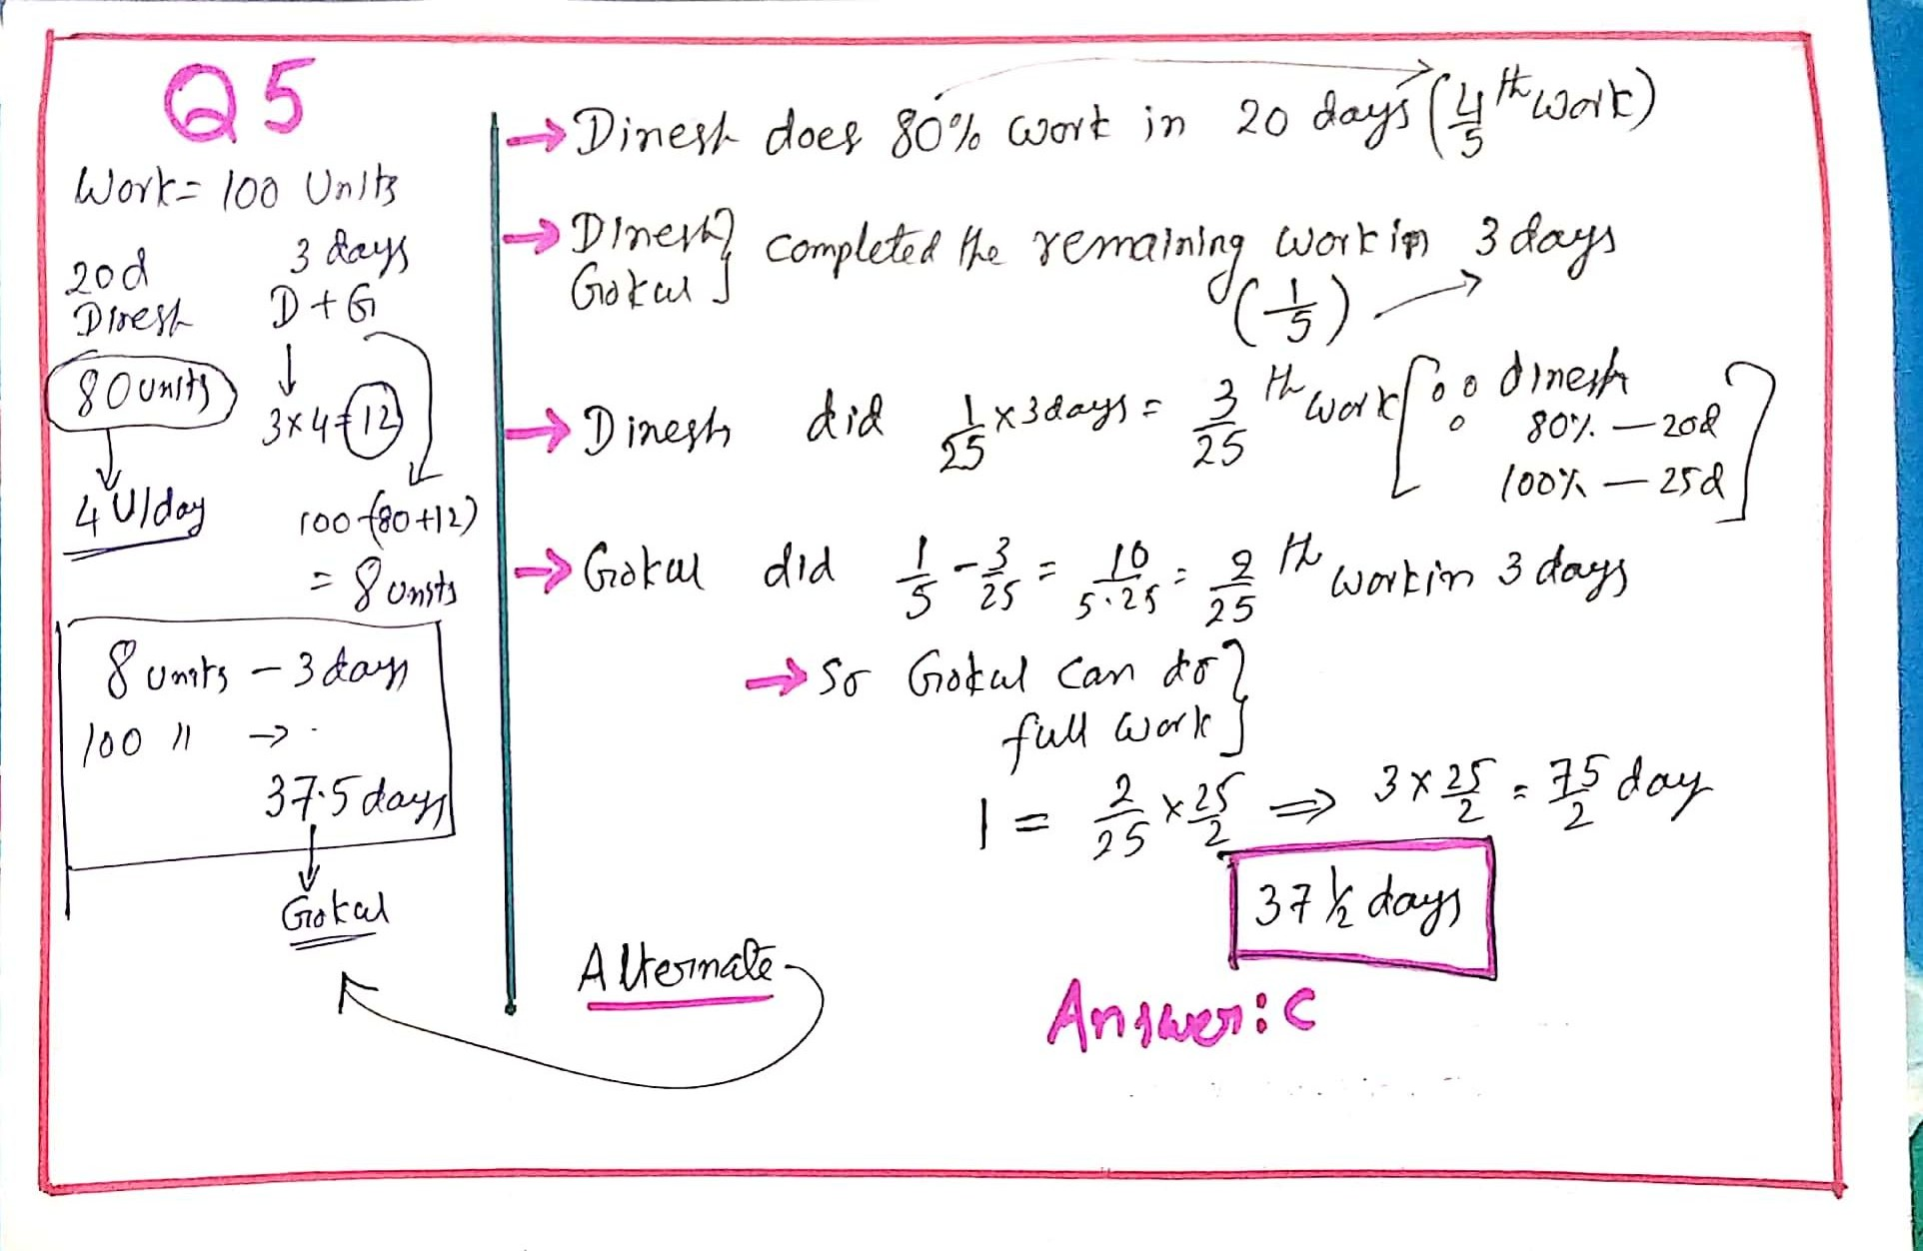
Q5.
Dinesh does 80 percent of a work in 20 days. He then calls in Gokul and they together finish the remaining work in 3 days. How long Gokul alone would take to do the whole work?
A)39 days B)37 days C)37 ½ days D)40 days Answer :C
on paper EXPLANATION

Slide 7
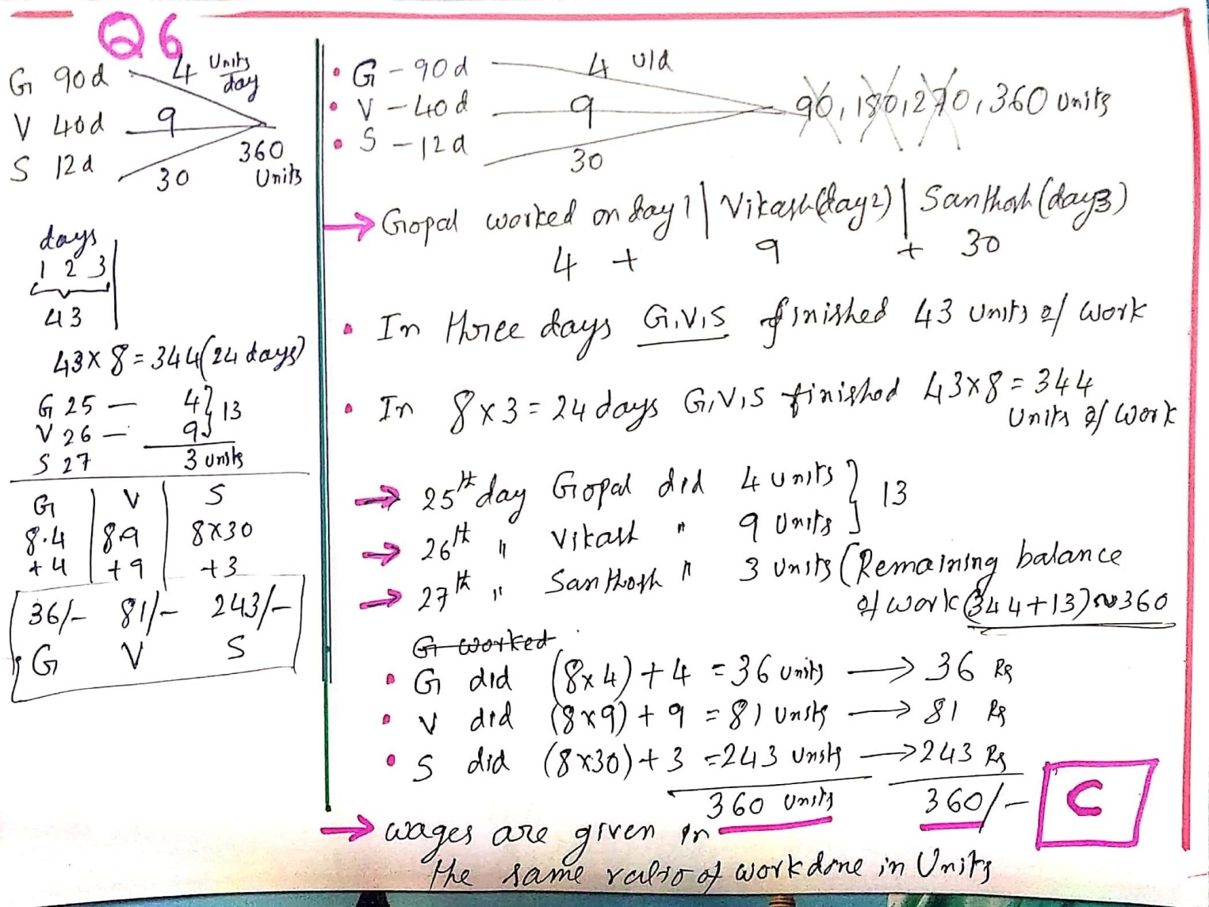
Q 6.___Gopal does a work in 90 days, Vikash in 40 days and Santhosh in 12 days. They work one after another for a day each, starting with Gopal followed by Vikash and then by Santhosh. If the total wages received are Rs 360 and Gopal, Vikash, Santhosh share them in the ratio of the work done, find their respective individual wages.
C.Rs 36, Rs 81 & Rs 243 (Answer :C) EXPLANATION

Slide 8
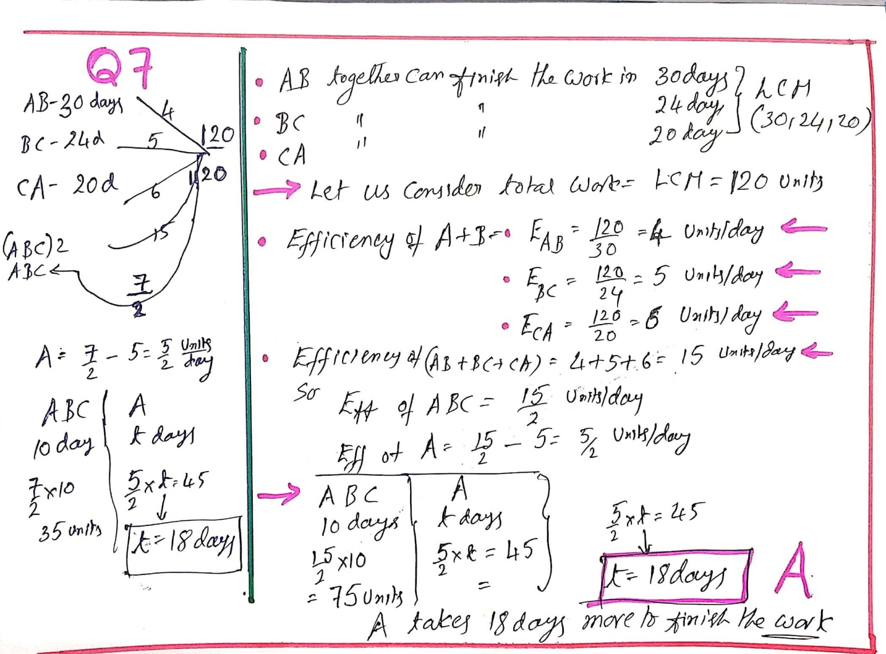
Q 7.
A and B can do a piece of work in 30 days , while B and C can do the same work in 24 days and C and A in 20 days . They all work together for 10 days when B and C leave. How many days more will A take to finish the work?
18 B) 24 C) 30 D) 36 Answer :A
on paper EXPLANATION

Slide 9
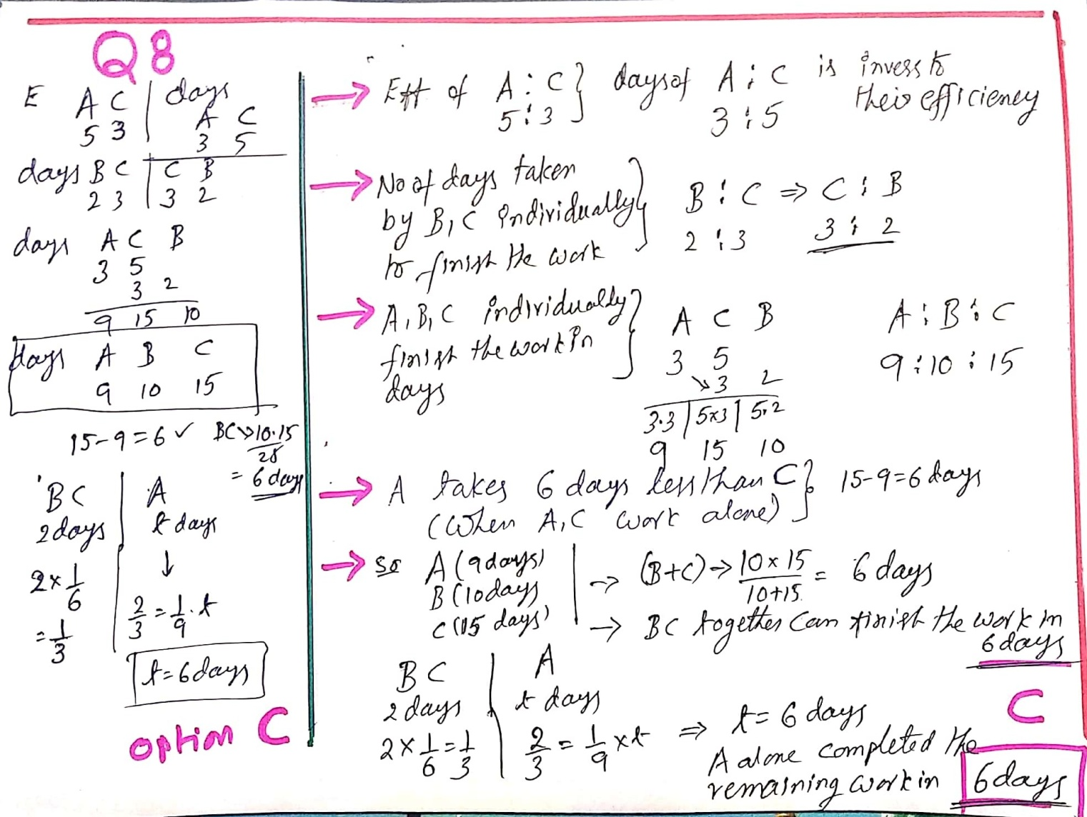
Q 8.__The ratio of efficiency of A is to C is 5:3. The ratio of number of days taken by B is to C is 2:3. A takes 6 days less than C, when A and C completes the work individually. B and C started the work and left after 2 days. The number of days taken by A to finish the remaining work is:
A) 4 B) 5 C) 6 D) 9 ( Answer :C)
on paper EXPLANATION

Slide 10
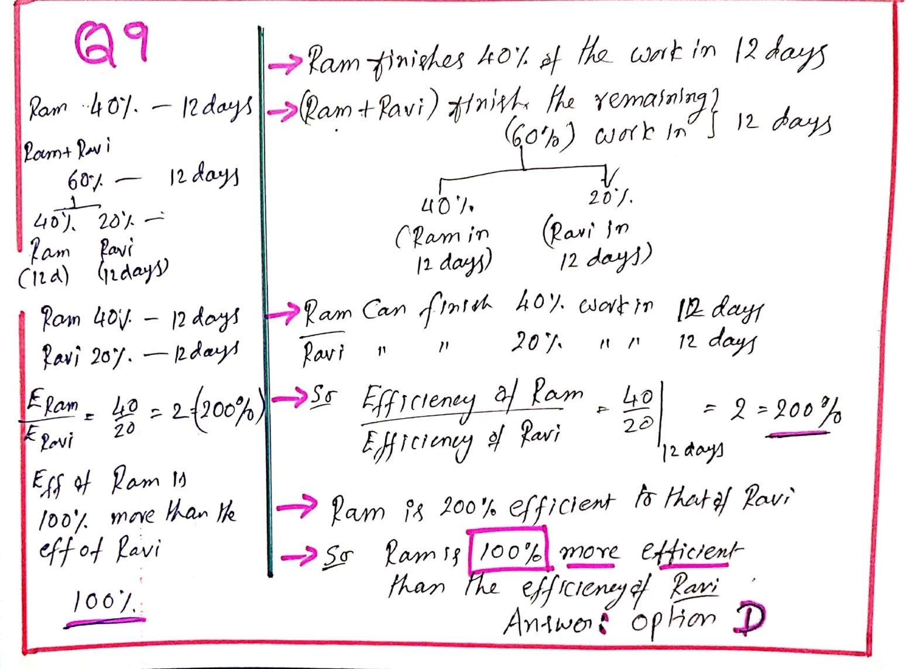
Q 9.____Ram starts working on a job and works on it for 12 days and completes 40 percentage of the work. To help him complete the work, he employs Ravi and together they work for another 12 days and the work gets completed. How much more efficient is Ram than Ravi?
50% B) 200% C) 60% D) 100% (Answer :D)
on paper EXPLANATION

Slide 11
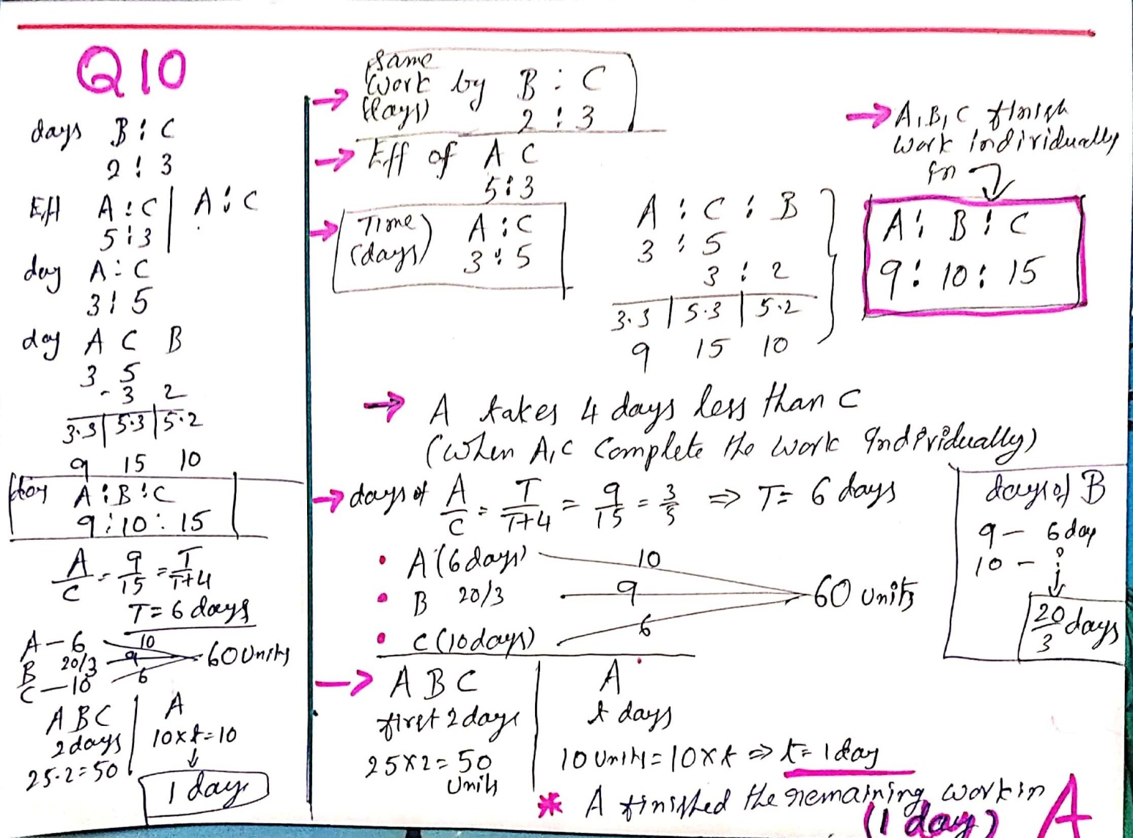
Q 10.___The ratio of number of days taken by B is to C is 2: 3. The ratio of efficiency of A is to C is 5: 3. A takes 4 days less than C, when A and C complete the work individually. A, B and C started the work and B & C left after 2 days. The number of days taken by A to complete the remaining work is: A) 1 day B) 2 days C) 3 days D) 5 days ( Answer :A)
on paper EXPLANATION

Slide 12
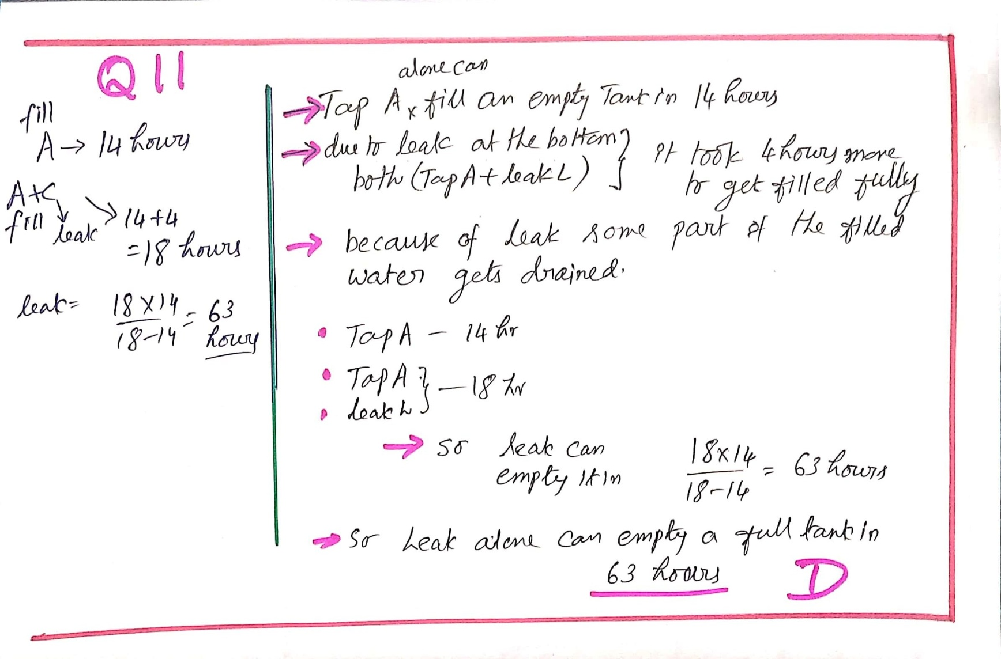
Q 11.
A water tank normally takes 14 hours to be filled by a tap but because of the leak, it takes another 4 hours. In how many hours will the leak empty a full water tank?
50.5 hours B) 54.4 hours C) 60 hours D) 63 hours ( Answer :D)
on paper EXPLANATION

Slide 13
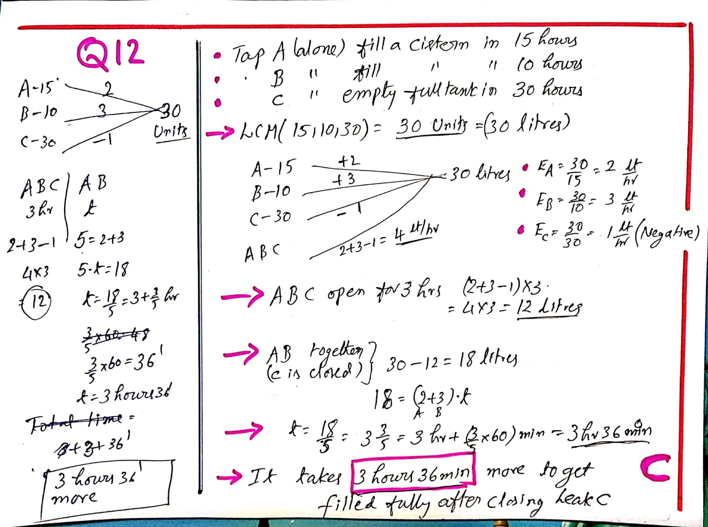
Q 12.__Two pipes A and B can fill a cistern in 15 hours and 10 hours respectively. A tap C can empty the full cistern in 30 hours. All the three taps were open for 3 hours, when it was remembered that the emptying tap had been left open. It was then closed. How many hours more would it take for the cistern to be filled? C) 3 hr 36 min. (Answer :C) on paper EXPLANATION

Slide 14
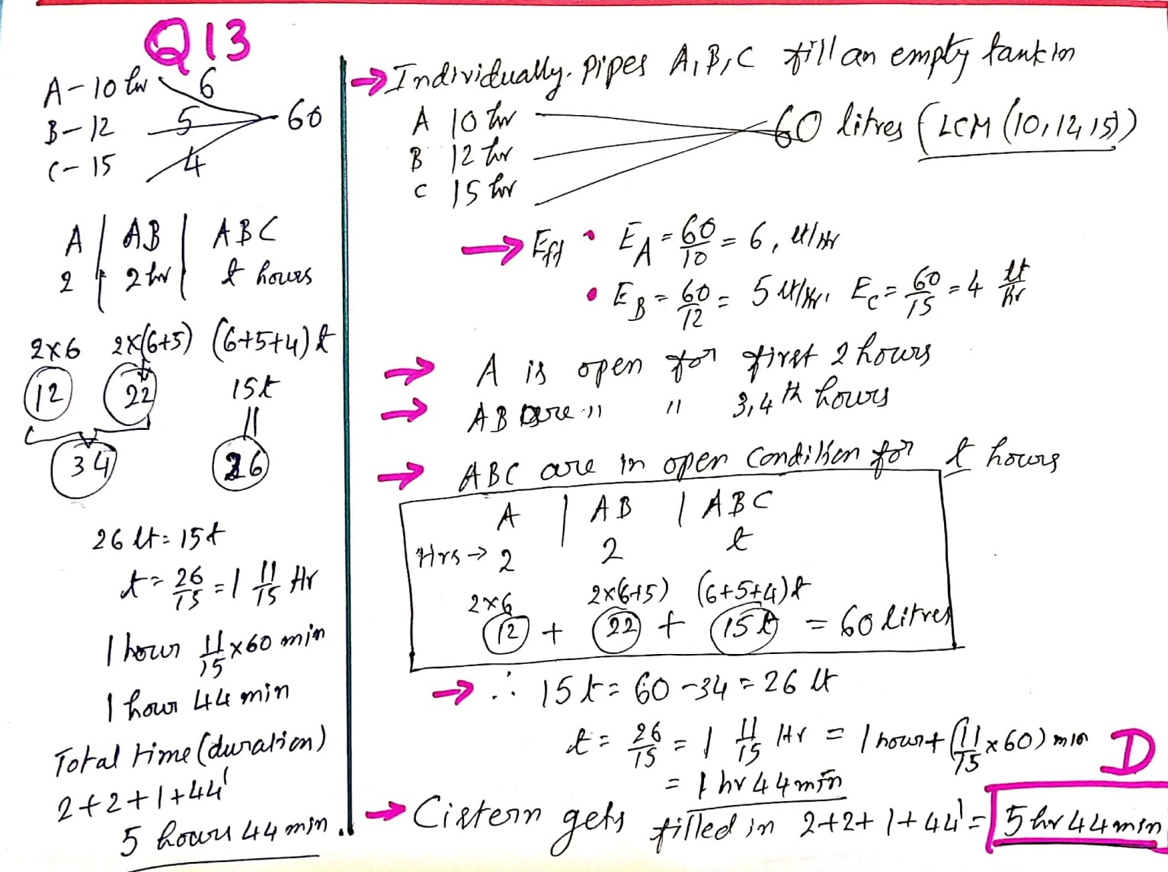
Q 13.__Three pipes A, B and C can fill a cistern in 10 hours, 12 hours and 15 hours respectively. First A was opened. After 2 hour, B was opened and after 4 hours from the start of A, C was also opened. Find the time in which the cistern is just full.
2 hours B) 4 hours C) 2 hours 52 min D) 5 hours 44 min. (Answer :D) EXPLANATION

Slide 15
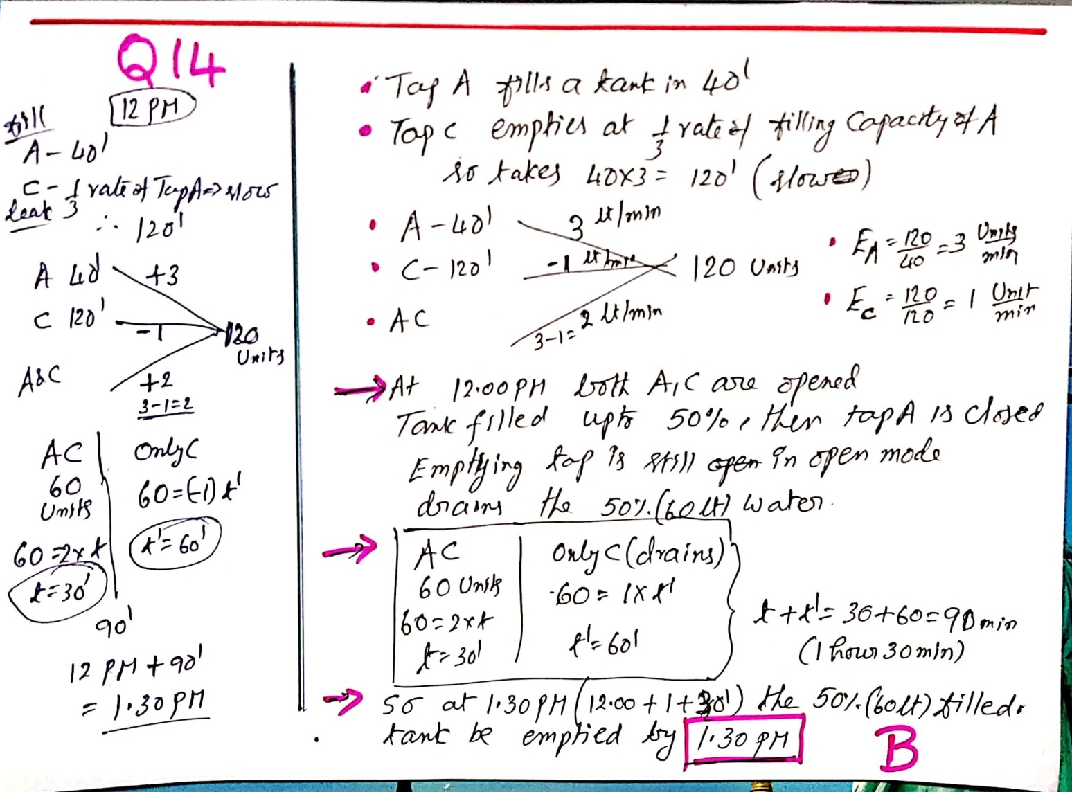
Q 14.___Tap A fills a tank in 40 minutes while tap C empties it at 1/3rd the rate at which A fills it. At 12 : 00 noon, A and C are simultaneously started and when the tank is 50% full, tap A is turned off. At what time will the tank be empty?
A) 1 : 45 pm B) 1 : 30 pm C) 12 : 30 pm D) 12 : 45 pm (Answer :B) on paper EXPLANATION

Slide 16
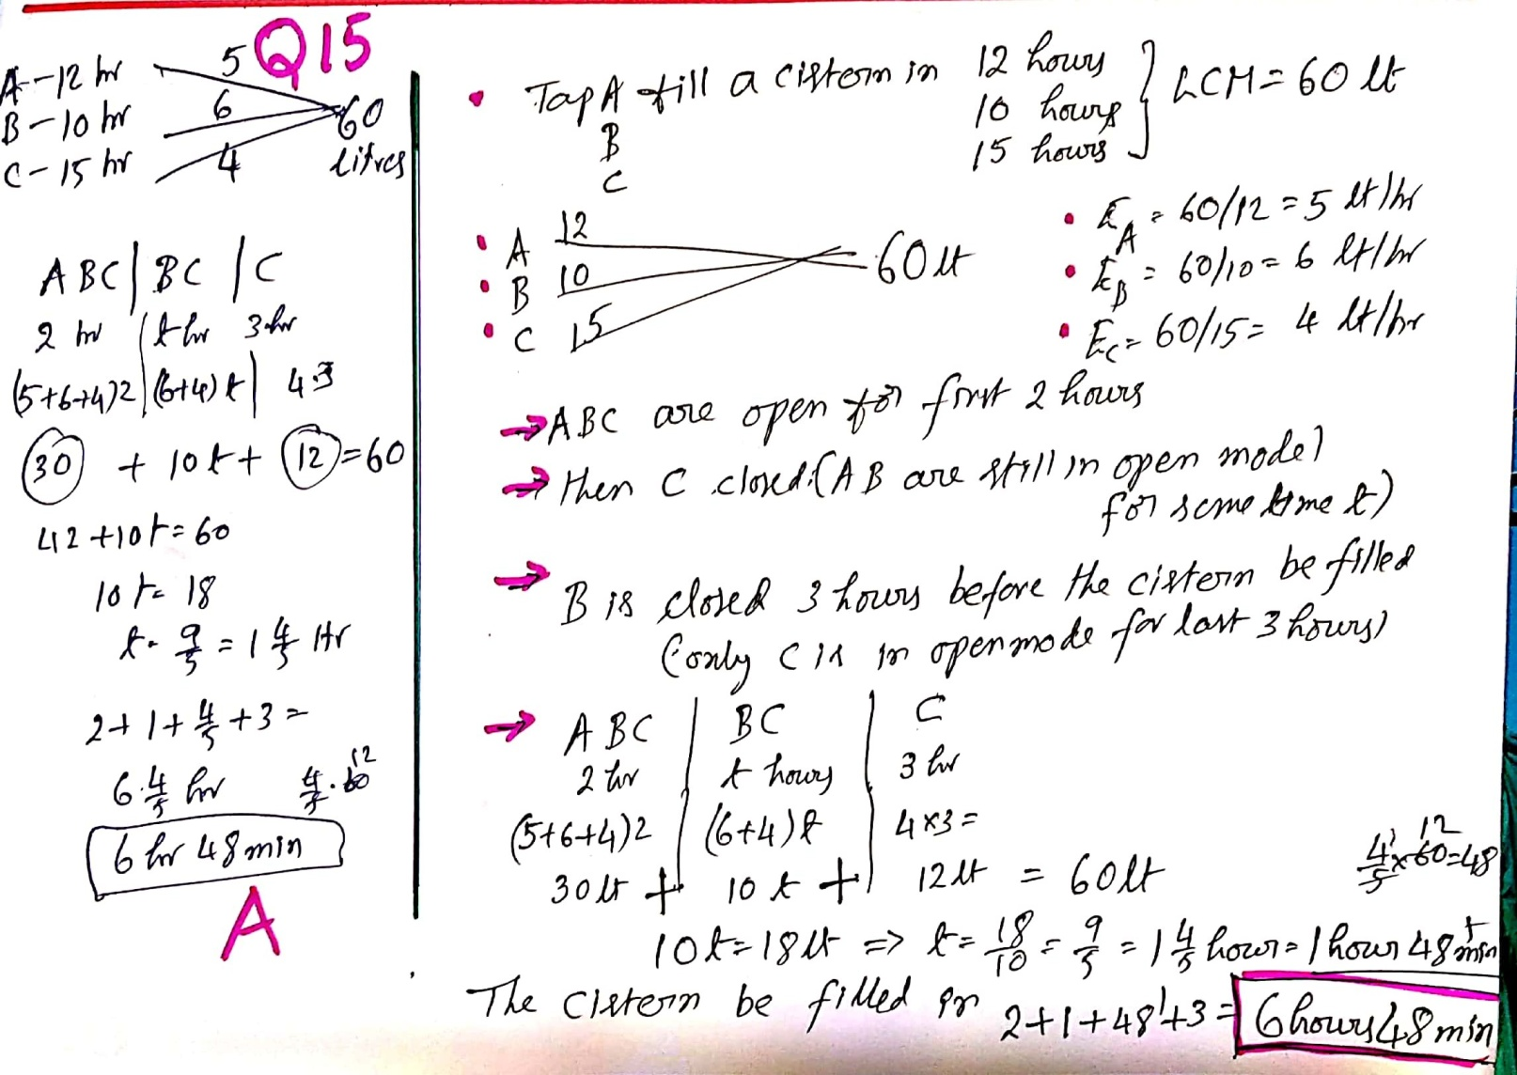
Q 15._Tap A can fill a cistern in 12 hours, B in 10 hours and C in 15 hours. They all are opened together, but A is closed after 2 hours of starting and B is closed 3 hours before the cistern to be filled. In how much time will the cistern be filled? A) 6 hours 48 min (Answer :A)
on paper EXPLANATION

Slide 17
Thank You

